Slide 1

Machine Learning Based Automated Construction Planning System for Sri Lanka
24-25J-201

Slide 2
THIS IS OUR TEAM
Supervisor - Mr. Supunya Swarnakantha
Co- Supervisor - Dr. Dharshana Kasthurirathna
SATHURJAN . K IT21188718
LINGANTHAN . J IT21223808
SILVA A A I IT21301254
RA AHAMED
IT21188718

Slide 3


Introduction
Automated construction is a user-friendly website for users . It uses machine learning to analyze neck circumference cost estimation, material recommends, solar panel specifications Interior Design ,
Simple interface for accessibility to all users
The system aims to automate key planning tasks, enhance decision-making accuracy, and improve project efficiency

Slide 4

Research Question
Accurate, real-time cost and material estimates, considering local market variations and project specifics?
Recommend suitable materials using building plans and weather data, and what are the impacts on durability
What techniques can recommend optimal solar panel specifications and pricing based on energy consumption, location, and technology?
Learning tools improve communication between clients and architects, ensuring requirements are effectively incorporated into designs?

Slide 5




Objectives
Main Objective :
Specific Objectives
To develop architectural design process “Automated architectural plans”, developing a machine learning (ML) based system for automatic architecture planning
To integrate data processing techniques to accurately interpret complex architectural and climatic information
To ensure a user-friendly interface for widespread accessibility.
To Maintain high performance and quick response times

Slide 6
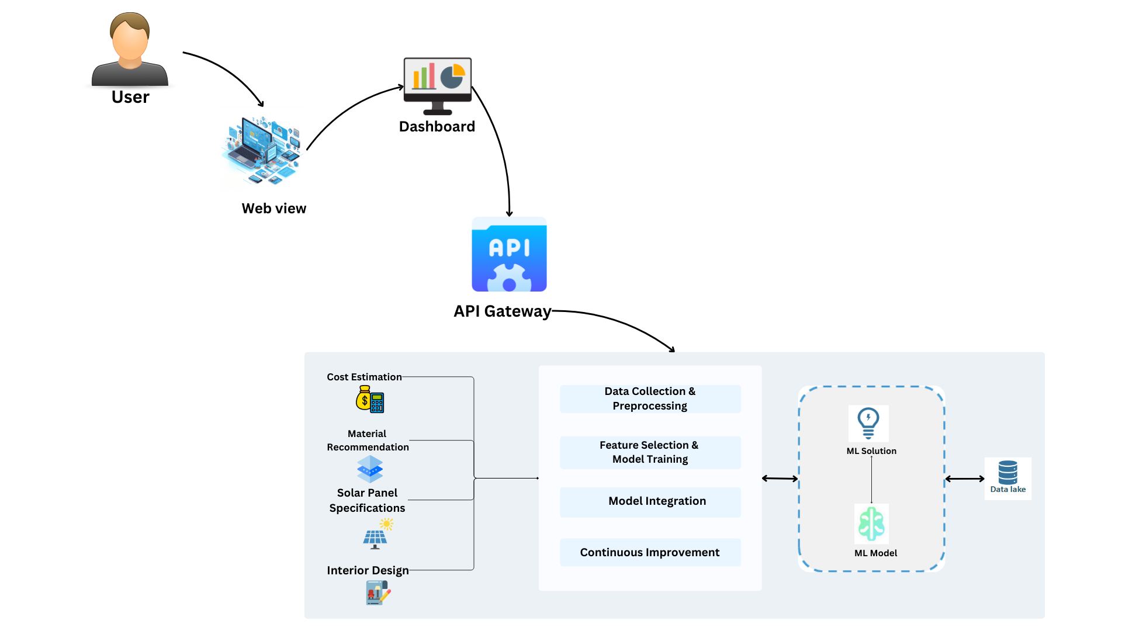
Overall System Diagram

Slide 7
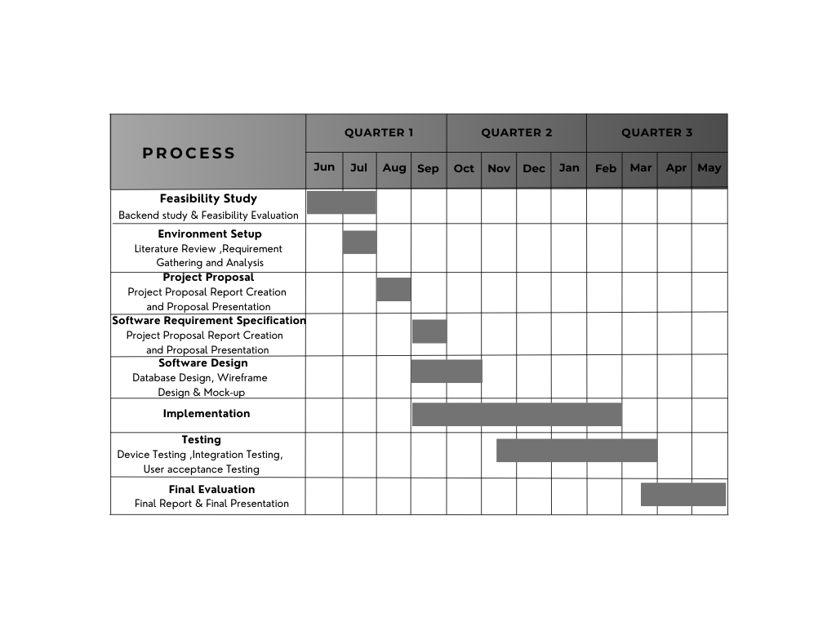
GANTT CHART
HERE
IT21301254 | Silva A.A.I | 24-25-201

Slide 8

IT21188718 | Sathurjan.K
BSc (Hons) in Information Technology Specializing in IT
IT21188718 | SATHURJAN.K| 24-25J-201

Slide 9
Introduction
Overview:
The real estate market faces challenges in accurately predicting land and house prices due to fluctuating market trends, diverse property features, and varying location-specific factors.
Project Aim:
Develop a machine learning-based system to predict land and house prices, tailored to Colombo's unique real estate market. The system will analyze factors such as property location, size, amenities, and neighborhood characteristics to provide accurate pricing insights.

Slide 10

RESEARCH PROBLEM
Accurately predicting land and house prices is essential in real estate, particularly given the dynamic market conditions and the unique characteristics of each property. However, challenges such as analyzing vast datasets on location, property size, amenities, and market trends, balancing affordability with accurate predictions, and adapting to local real estate regulations make this task complex.
IT21223808 | LINGANATHAN . J | 24-25J-201

Slide 11

Objectives
Main Objective
Specific Objectives
Implement evaluation methods to assess property features, market trends, and location-specific factors for accurate price predictions.
Integrate data processing techniques to analyze complex datasets, including property details and market dynamics.
Maintain high performance and quick response times, even with large datasets and complex prediction models.
Facilitate efficient decision-making and financial planning for property buyers, sellers, and investors.
Provide accurate land and house price predictions by analysing property details, market trends and location specific factors

Slide 12
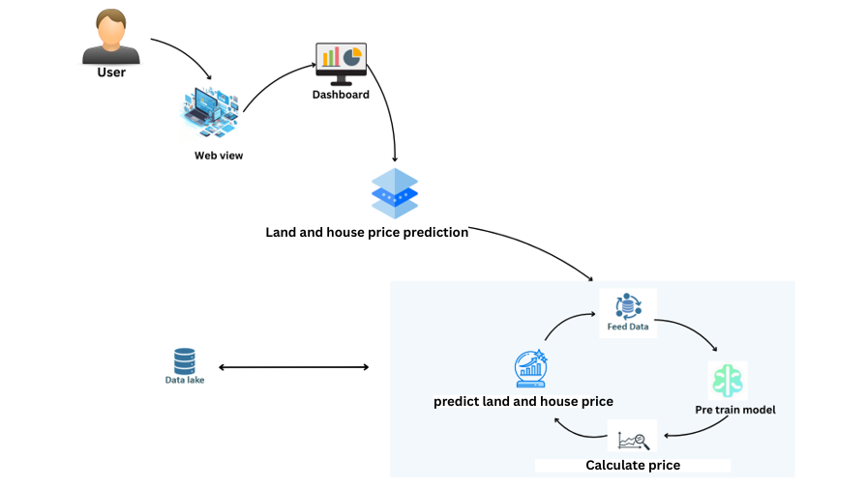
Component Diagram

Slide 13





TOOLS & TECHNOLOGIES
Colab
Python
React (vite)
Tailwind css
MongoDB (moongose)
Flask API
IT21223808 | LINGANATHAN . J | 24-25J-201

Slide 14
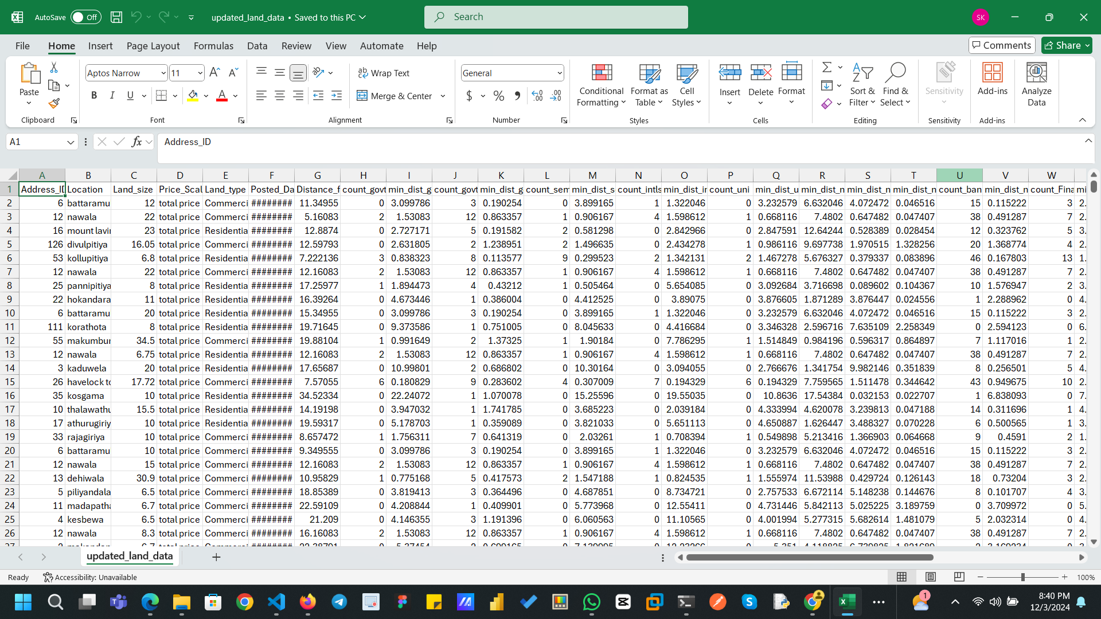
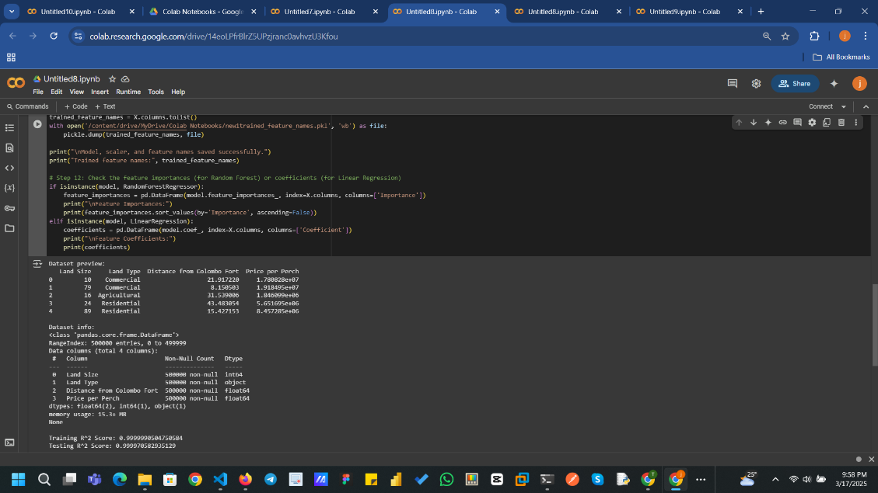
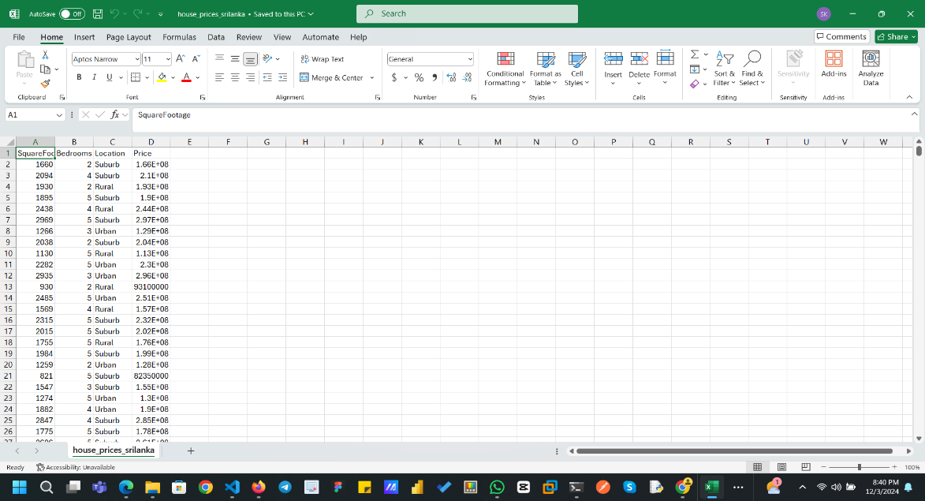
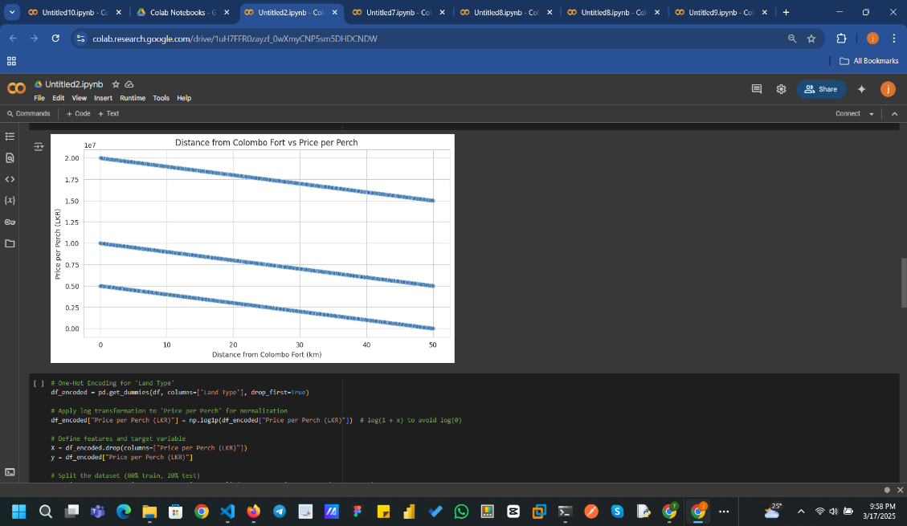
DATA COLLECTION & MODEL TRAINING

Slide 15
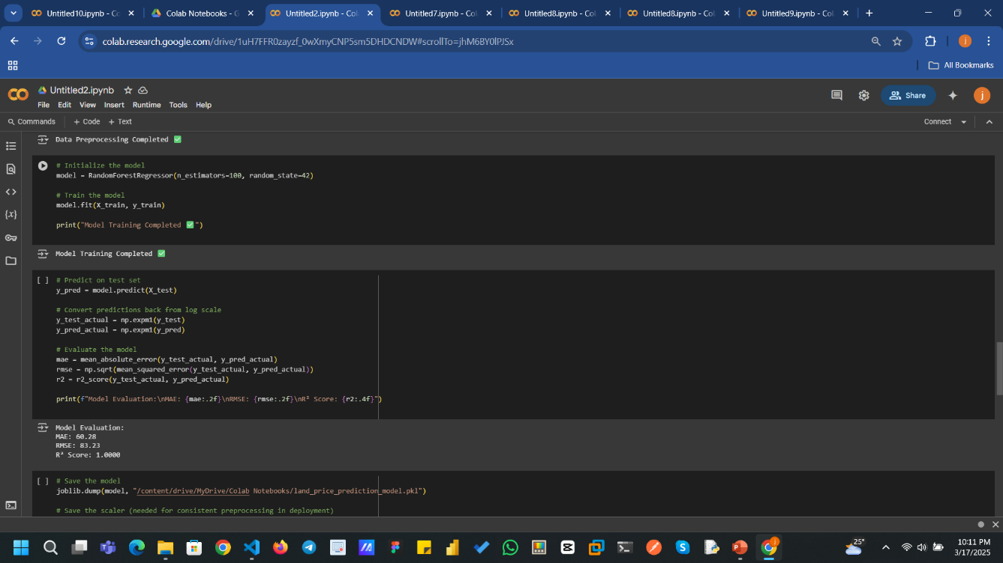
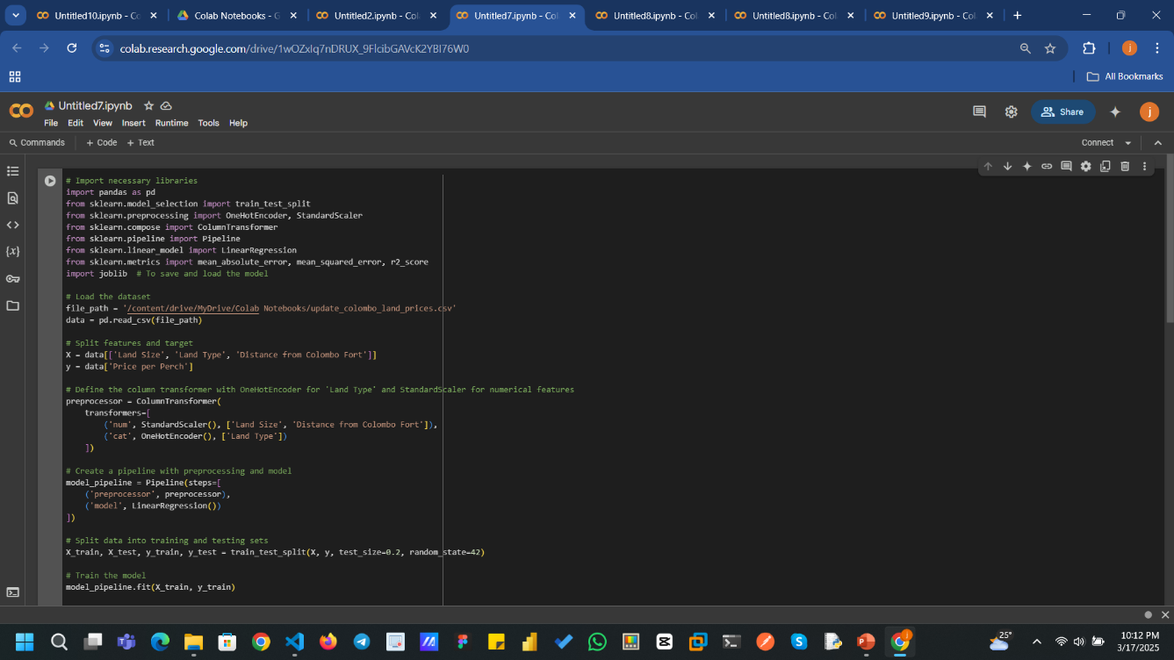
MODEL SELECTION

Slide 16
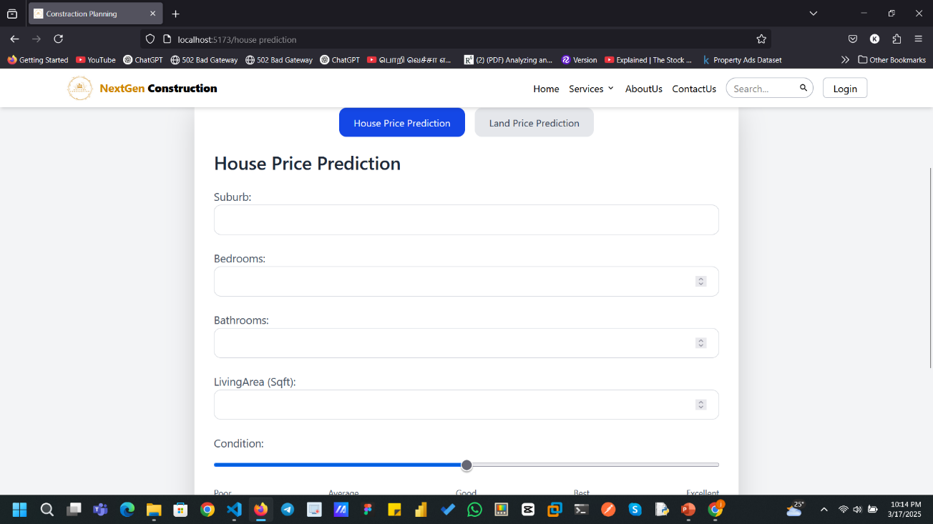
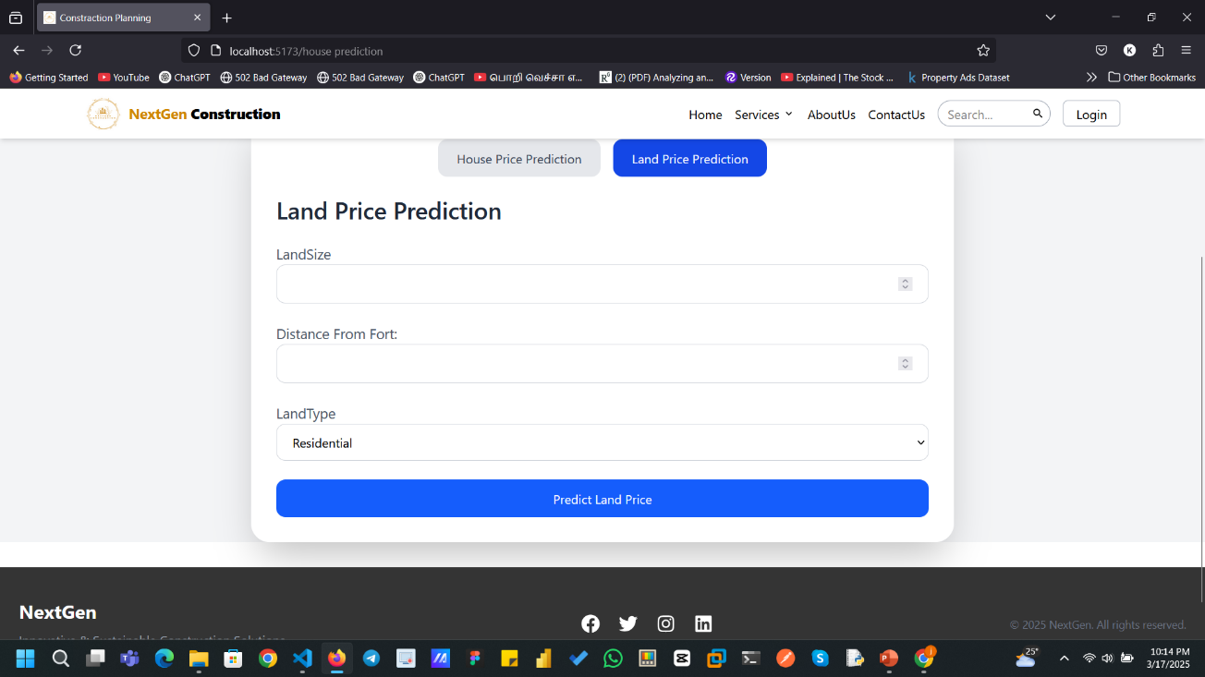
WORKING PRODUCT

Slide 17
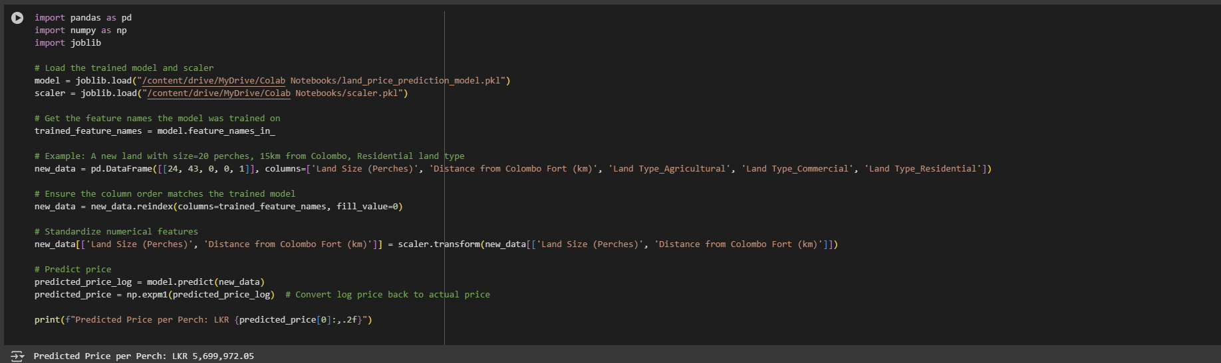
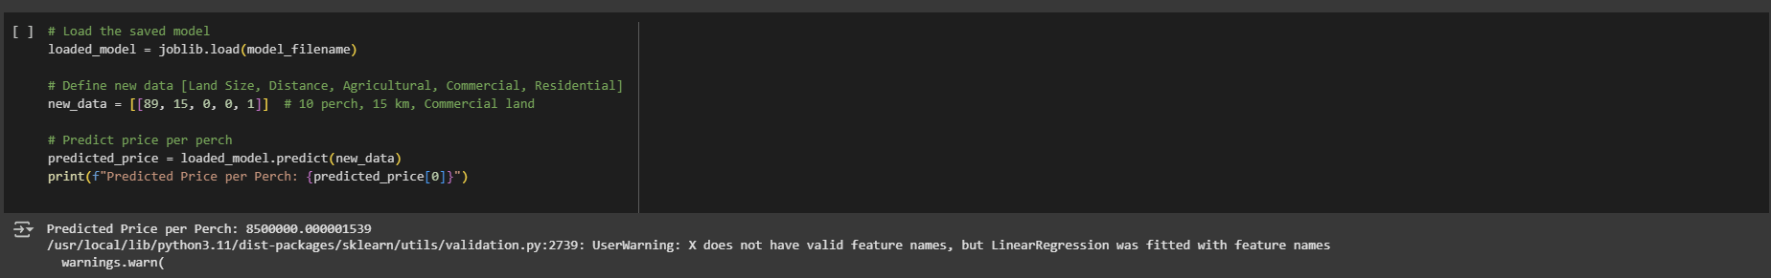
TESTING

Slide 18
REFERENCES
[1] “The easiest way to find the and compare building materials”, Available: https://2050-materials.com/.
[2]“Building Materials”, Available: https://www.bimobject.com/en/categories/building-materials.
[3] “Building Materials and Components statistics” : https://www.data.gov.uk/dataset/75ee36ed-21f7-4d7b-9e7c-f5bf4546145d/building-materials-and-components-statistics.
[3] “Climate change ” : https://www.data.gov.uk/dataset/75ee36ed-21f7-4d7b-9e7c-f5bf4546145d/building-materials-and-components-statistics.
[4]Kaggle : “Climate change Earth Surface Temperature Data” : https://www.kaggle.com/datasets/berkeleyearth/climate-change-earth-surface-temperature-data?select=GlobalLandTemperaturesByMajorCity.csv

Slide 19

IT21223808 |Linganathan.J
BSc (Hons) in Information Technology Specializing in IT
IT21223808 | LINGANATHAN . J | 24-25J-201

Slide 20
Introduction
Overview:
- Solar energy is a key solution to the growing energy needs and environmental concerns
- Harnessing solar power efficiently can significantly reduce carbon footprint and energy costs.
Project Aim:
- Develop a system to recommend optimal solar panel specifications and pricing.
- Base recommendations on estimated energy consumption and available land area.
IT21223808 | LINGANATHAN . J| 24-25J-201

Slide 21
Research problem
The growing demand for renewable energy necessitates cost-effective solar panel installations. However, challenges like predicting energy consumption, selecting suitable configurations, and balancing cost, efficiency, and space constraints remain.
The research aims to recommend solar panel specifications and pricing based on estimated energy consumption and available land area. It explores models, algorithms, selection methods, and cost estimation methods to develop a tailored system for reliable solar panel recommendations.
IT21223808 | LINGANATHAN . J | 24-25J-201

Slide 22
Objectives
Main Objective :
Specific Objectives
Ensure scalability and accuracy of the system.
Provide secure and private data handling.
Maintain high performance and quick response times.
users estimate the cost of solar panel installations and determine how many panels can fit on a given land area based on their location , land size and desired capacity Develop a user-friendly interface for data collection.
Create algorithms to calculate land area and estimate power demand.
Develop a user-friendly interface for data collection.
Integrate cost consumption estimation using Linear Regression and Clustering Algorithms.

Slide 23
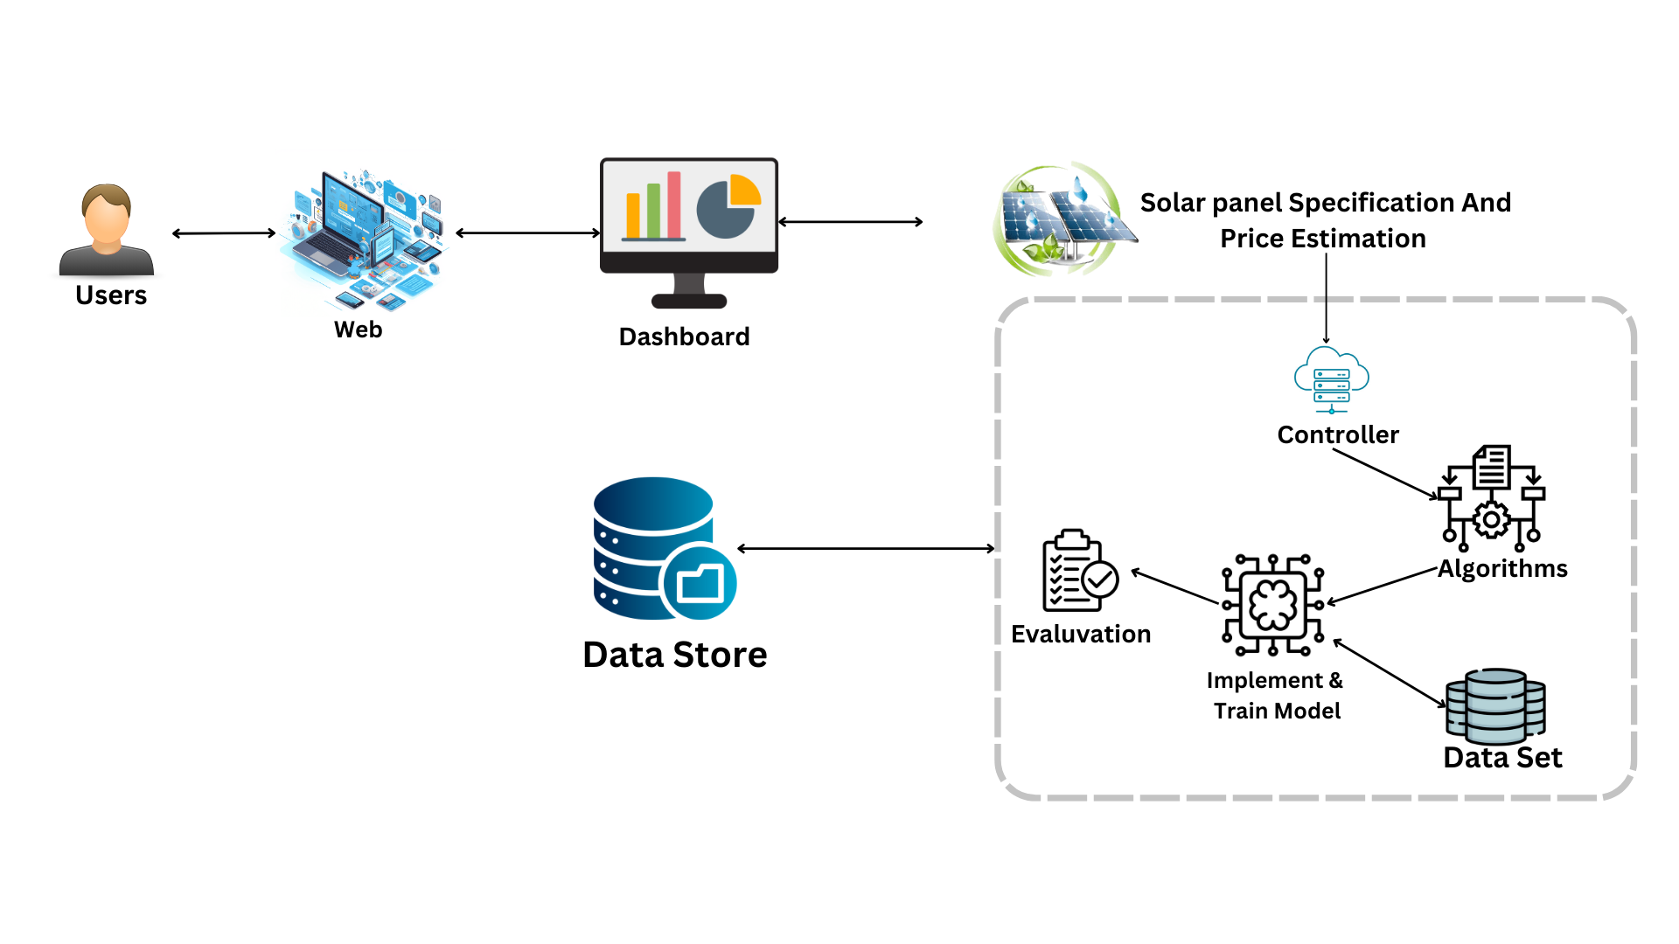
Component Diagram
IT21223808 | LINGANATHAN . J| 24-25J-201

Slide 24
TOOLS & TECHNOLOGIES
Colab
Python
React (vite)
Tailwind css
MongoDB (moongose)
Flask API
IT21223808 | LINGANATHAN . J | 24-25J-201

Slide 25
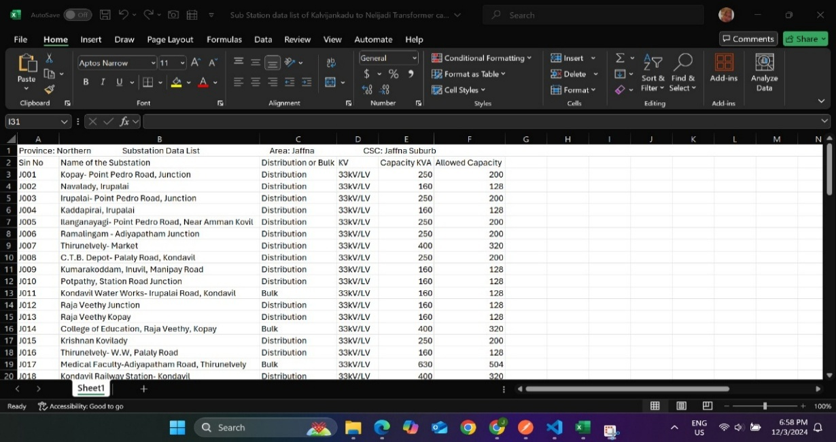
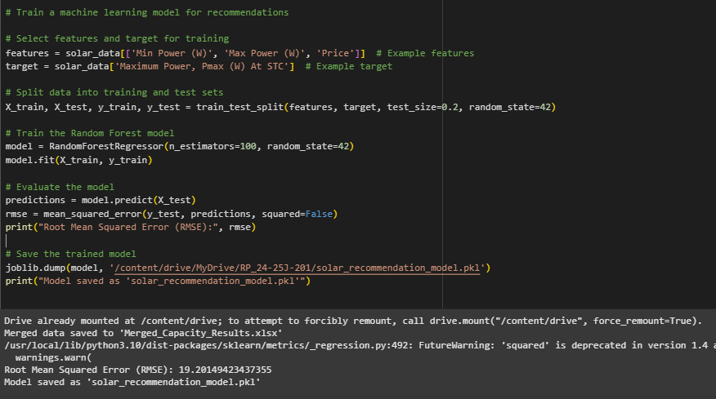
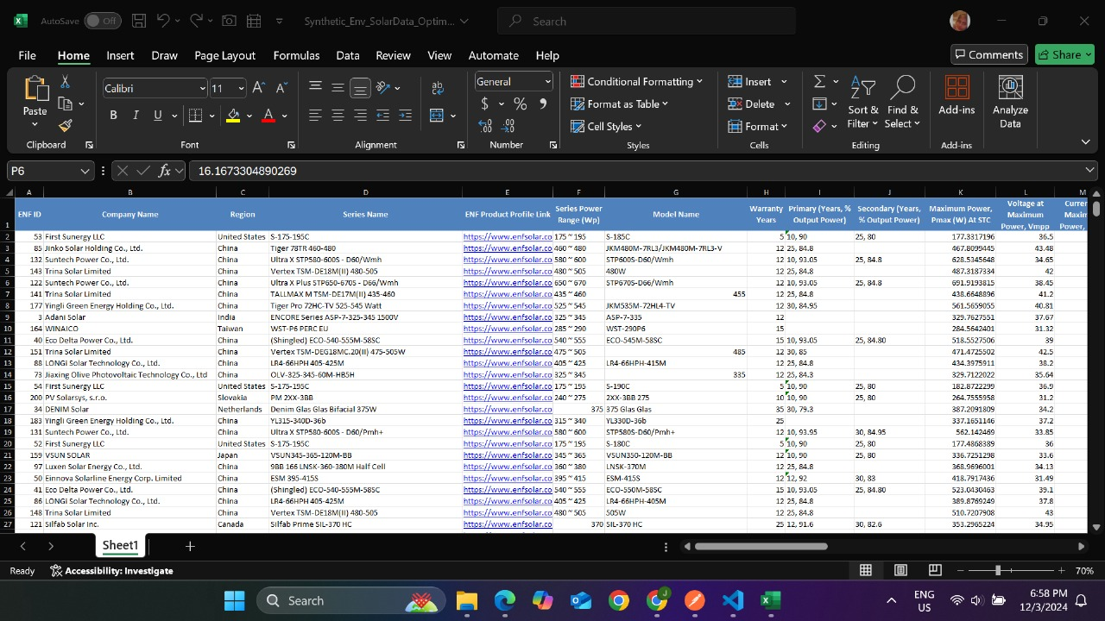
Data collection & Model Training

Slide 26
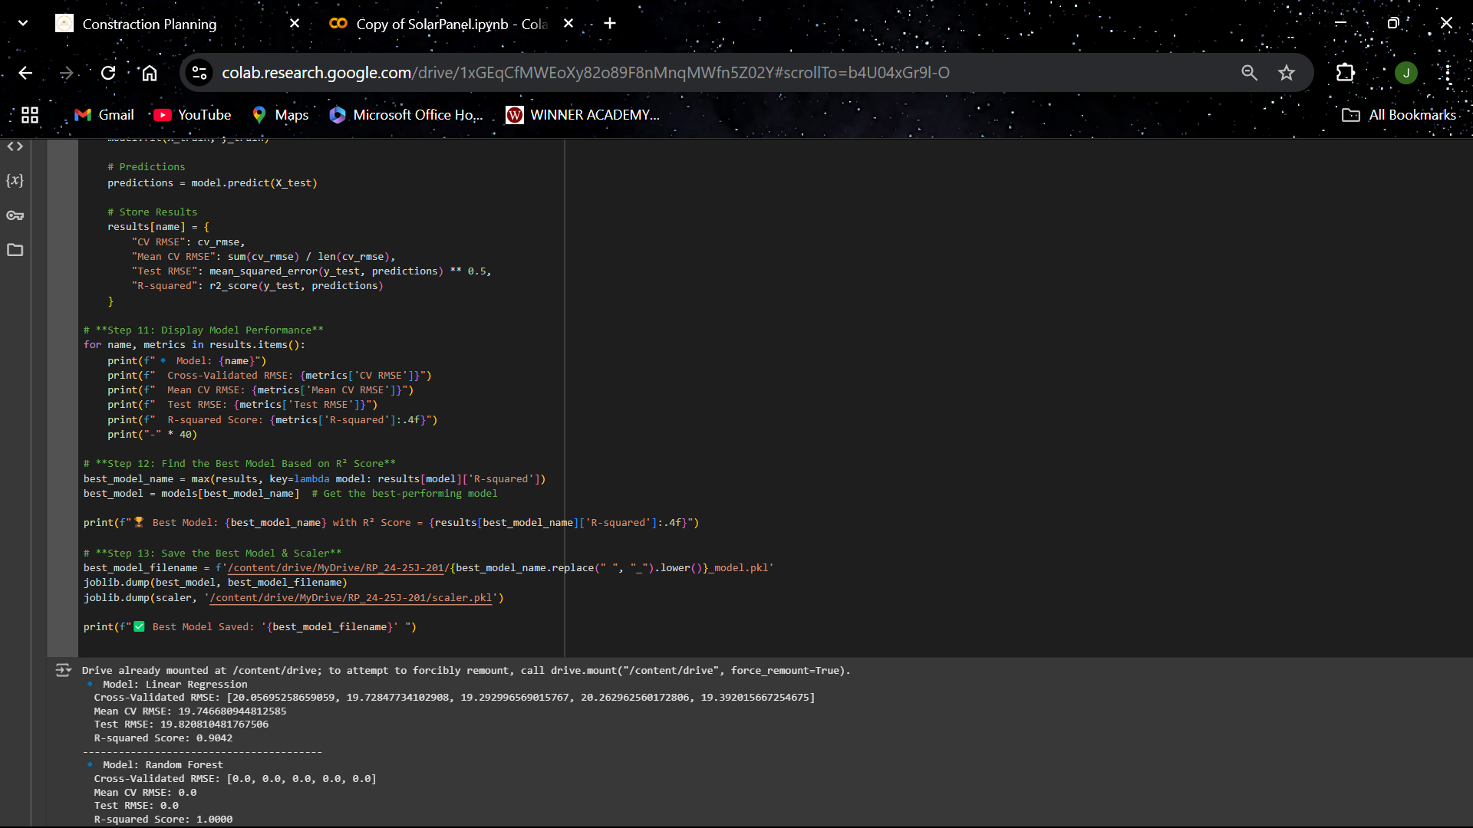
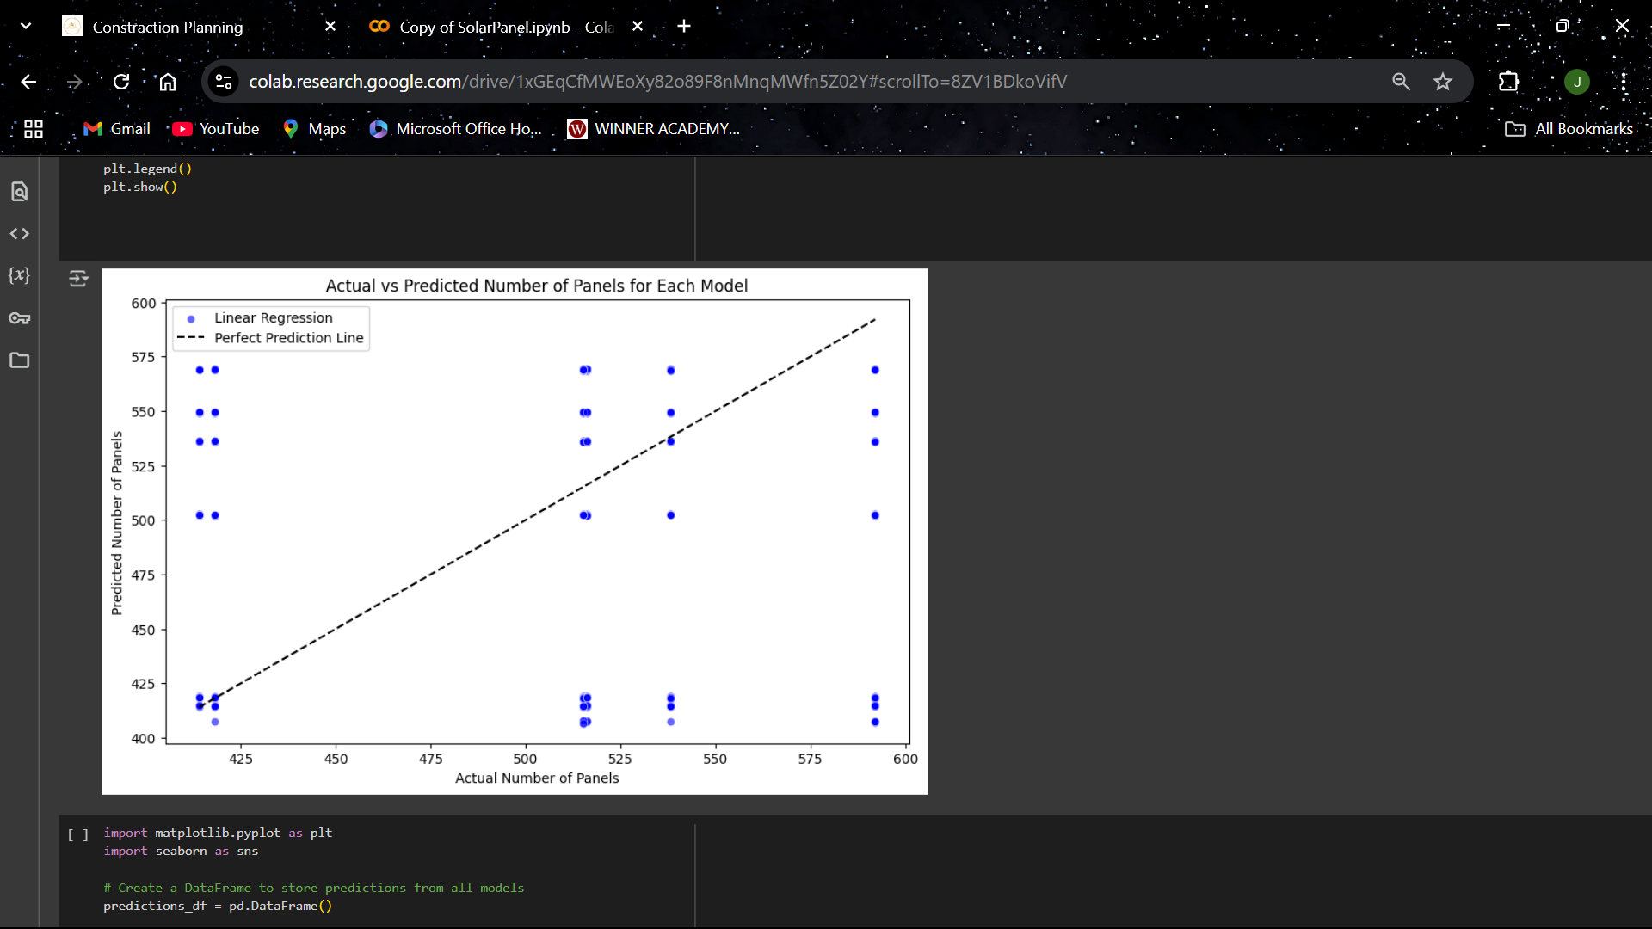
MODEL SELECTION
IT21223808 | LINGANATHAN . J | 24-25J-201

Slide 27
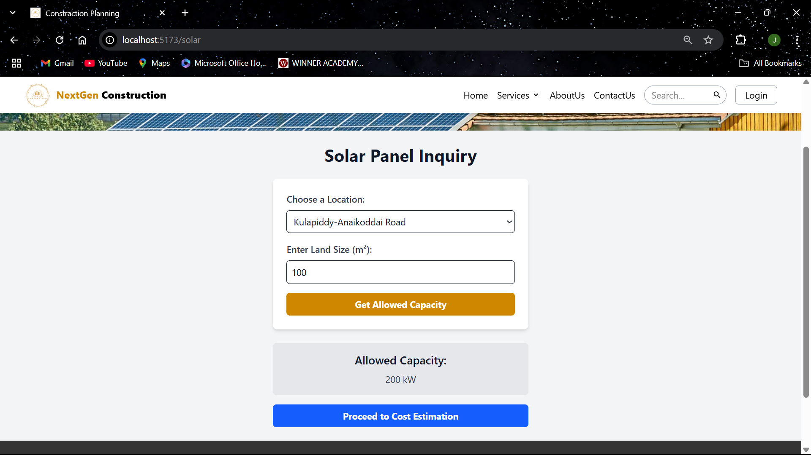
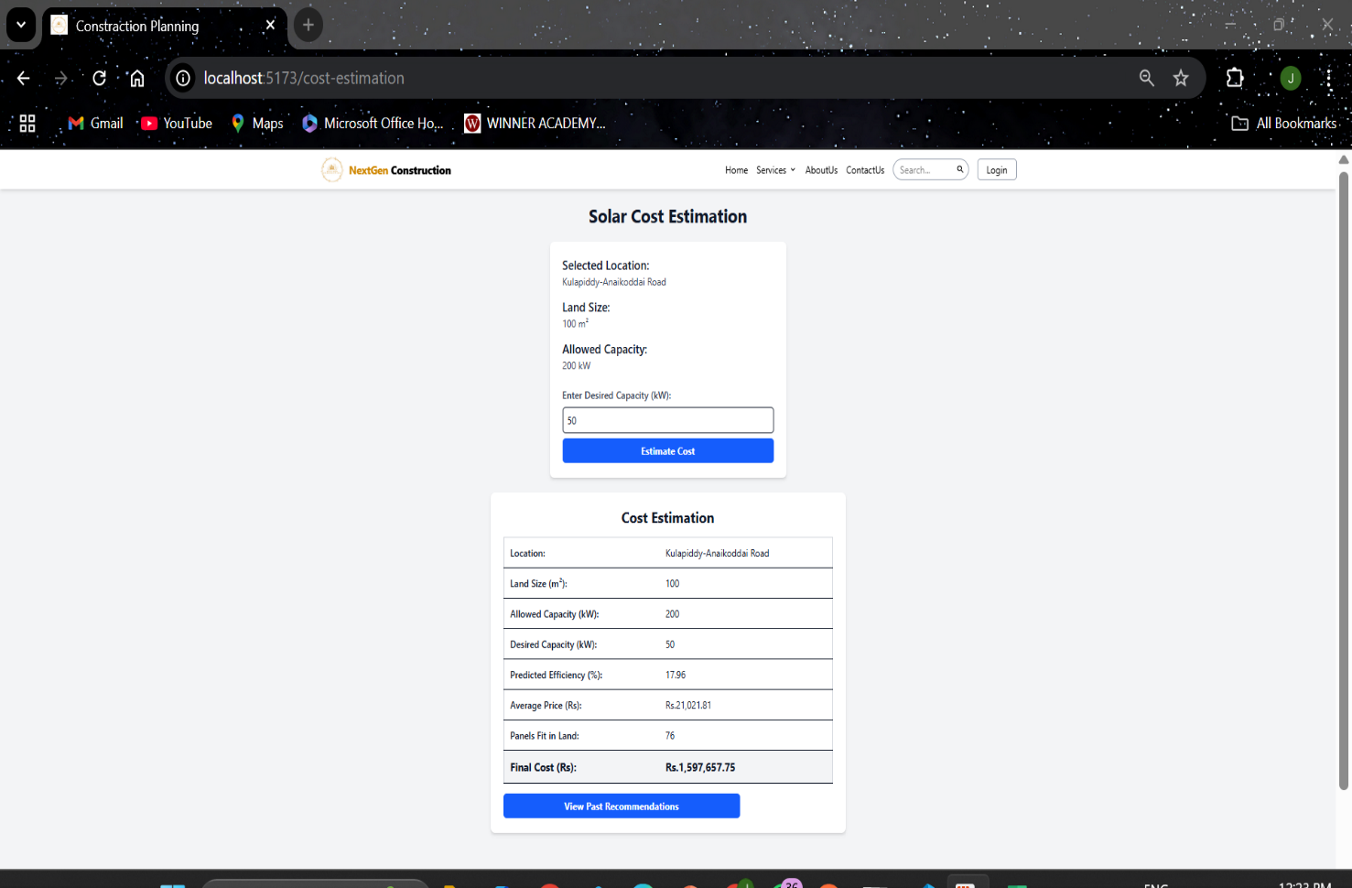
WORKING PRODUCT
IT21223808 | LINGANATHAN . J | 24-25J-201

Slide 28
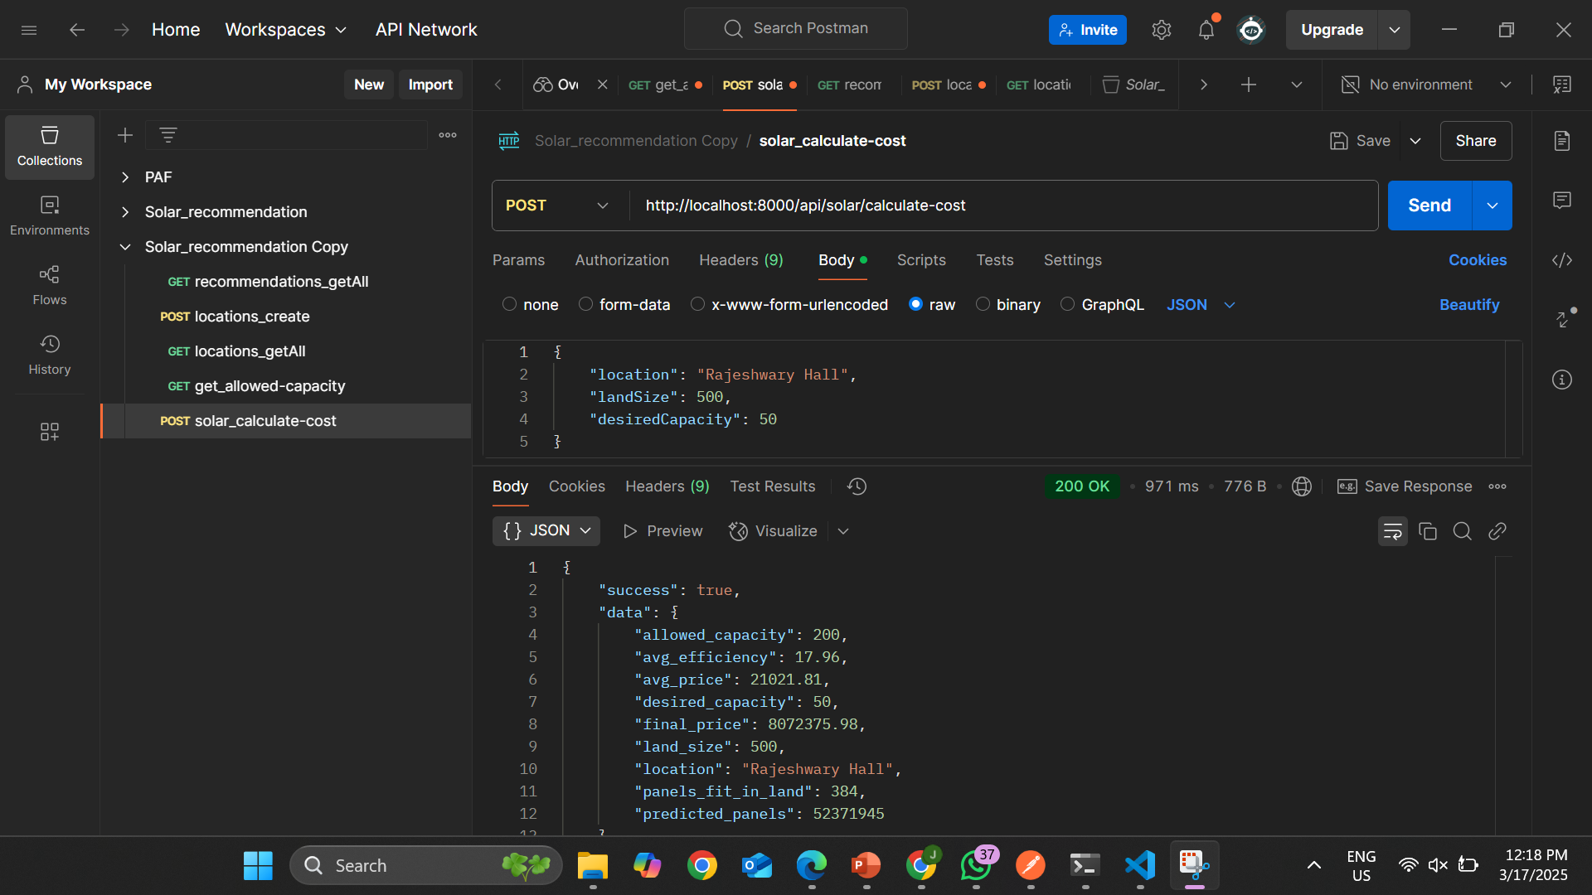
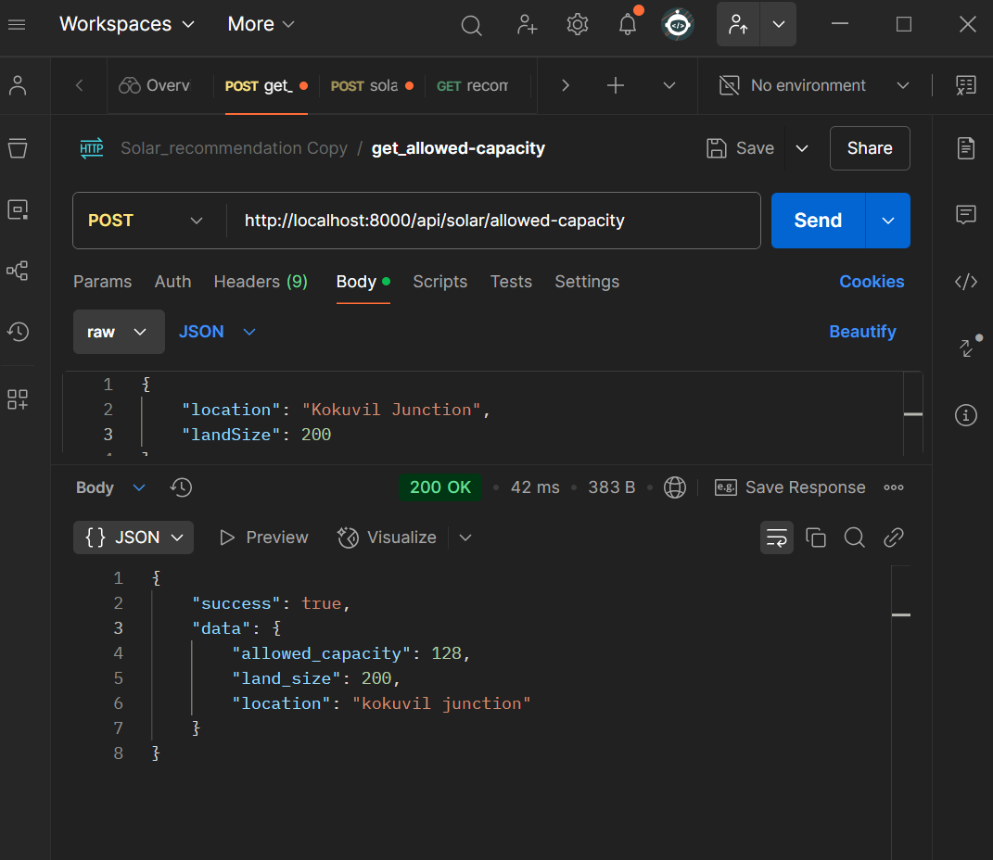
TESTING

Slide 29
REFERENCES
[1] Ani Kannal, “Solar Power Generation Data: Solar power generation and sensor data for two power plants”, Feb,2020, Available: https://www.kaggle.com/datasets/anikannal/solar-power-generation-data/data.
[2] Meshva , “Solar energy power generation dataset: Solar power generated from a solar plant”, May,2021, Available: https://www.kaggle.com/datasets/stucom/solar-energy-power-generation-dataset .
[3] UK Power Networks , “Photovoltaic (PV) Solar Panel Energy Generation data: UK Power Networks”, April,2022, Available: https://data.london.gov.uk/dataset/photovoltaic--pv--solar-panel-energy-generation-data .
[4] Yingchen Zhang (Manager, Sensing, Measurement, and Forecasting Group), “Solar Power Data for Integration Studies(NREL's Solar Power Data for Integration Studies are synthetic solar photovoltaic (PV) power plant data points for the United States representing the year 2006,” Jun. 2023, Available: https://www.nrel.gov/grid/solar-power-data.html .
[5] Sheffield Solar , “PV_Live:Live PV generation,” 03 August. 2024, Available: https://www.solar.sheffield.ac.uk/pvlive/ .
[6] Nate Blair, Nicholas DiOrio, Janine Freeman,Paul Gilman, Steven Janzou, Ty Neises, and Michael Wagne, “System Advisor Model (SAM) General Description,” national laboratory of the U.S. Department of Energy Office of Energy Efficiency & Renewable Energy Operated by the Alliance for Sustainable Energy, LLC, vol. 2017.9.5, TP-6A20-70414, May. 2020, doi: http://www.osti.gov/scitech .
IT21223808 | LINGANATHAN . J| 24-25J-201

Slide 30

IT21188718 |R A Ahamed
BSc (Hons) in Information Technology Specializing in IT
IT21158018 | R A AHAMED | 24-25J-201

Slide 31
Introduction
Overview:
Construction projects often have trouble estimating costs because material prices change and project needs are different.
Accurate and flexible estimation methods can greatly help with budgeting and planning for projects.
Project Aim:
Develop a system that uses machine learning to provide real-time construction cost and material estimations.
Use current market data and past trends to make sure the estimates are accurate and can adjust to changes.
IT21158018 | R A AHAMED | 24-25J-201

Slide 32
RESEARCH PROBLEM
The construction industry still uses old methods for cost estimation, which often leads to mistakes and overspending.
This project aims to use machine learning to improve cost predictions by adjusting them based on real-time data, fixing these problems.
IT21158018 | R A AHAMED | 24-25J-201

Slide 33
Objectives
Objectives
Specific Objectives
Create a strong machine learning model that can predict construction costs and material needs accurately and adjust as needed.
Improve the model's ability to adjust to new data and make more accurate estimates as time goes on.
Create an easy-to-use interface where users can enter project details and get cost and material estimates.
Use past data to improve the model’s ability to make accurate predictions and respond to changes.
IT21158018 | R A AHAMED | 24-25J-201

Slide 34
Research Gap
Lack of Dynamic Methods: Current research does not offer flexible and adjustable methods for estimating construction costs and materials.
Reliance on Static Data: Existing methods often use fixed data, which doesn't consider real-time changes in material prices and labor costs.
Need for Adaptive Approach: There's a clear need for a more flexible, data-driven approach to overcome these issues.
Proposed Solution: This research proposes developing a system that uses machine learning algorithms to adjust cost estimates dynamically.
IT21158018 | R A AHAMED | 24-25J-201

Slide 35
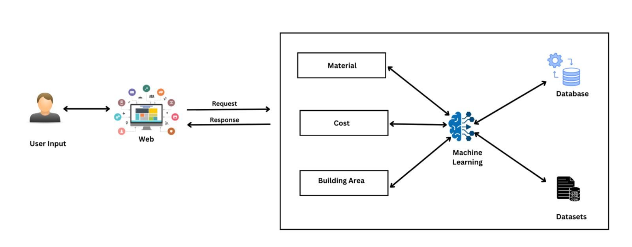
Component Diagram
IT21158018 | R A AHAMED | 24-25J-201

Slide 36
TOOLS & TECHNOLOGIES
Colab
Python
React (vite)
Tailwind css
MongoDB (moongose)
Flask API
IT21158018 | R A AHAMED | 24-25J-201

Slide 37
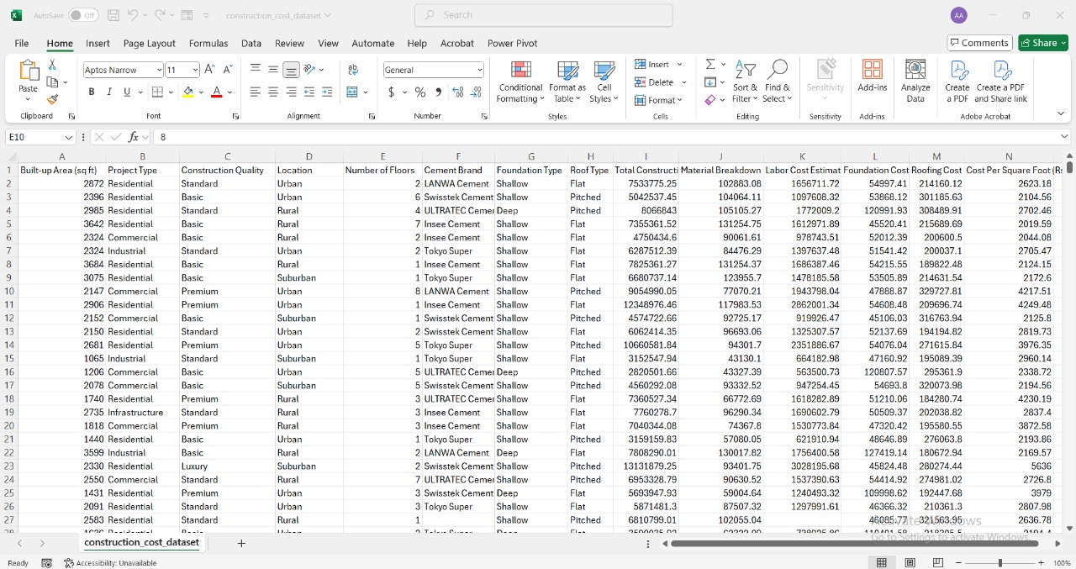
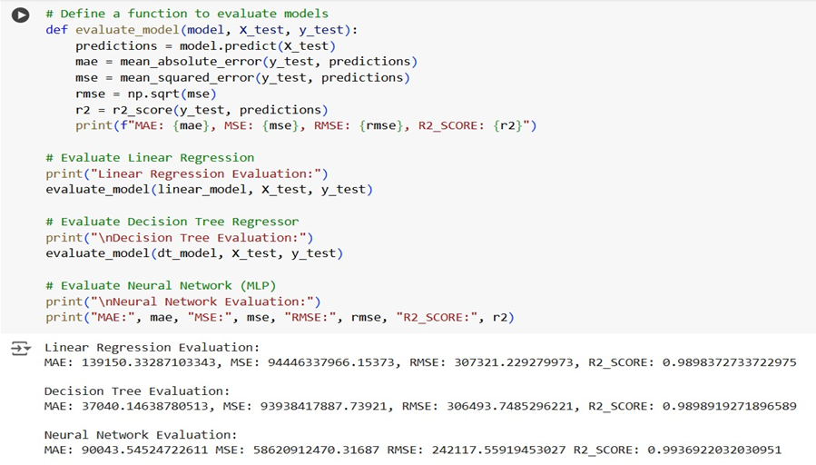
DATA COLLECTION & MODEL TRAINING

Slide 38
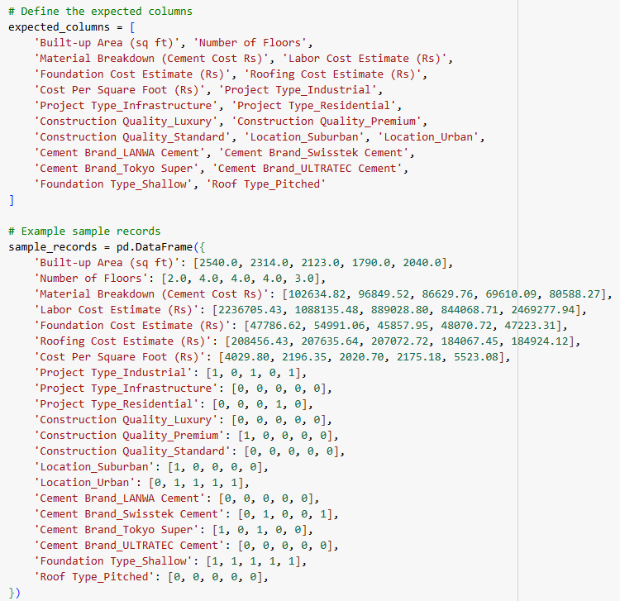
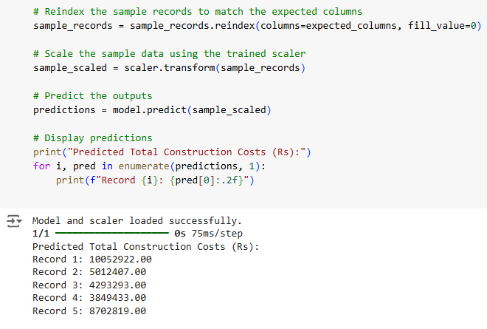
MODEL SELECTION

Slide 39
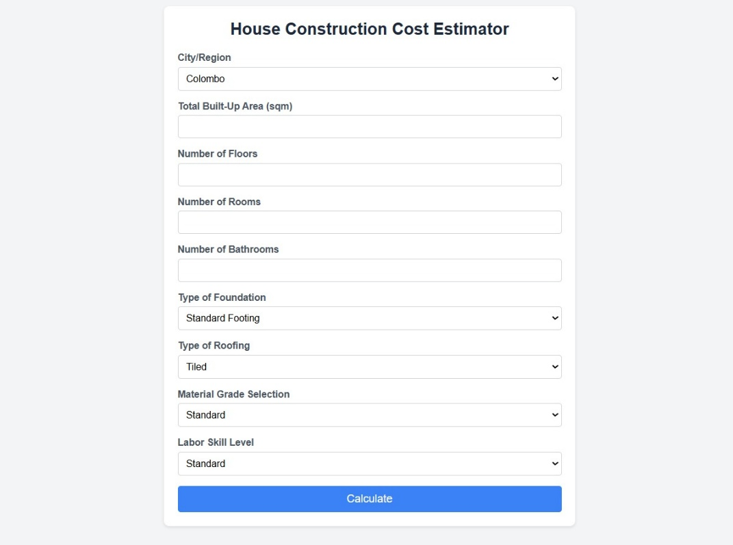
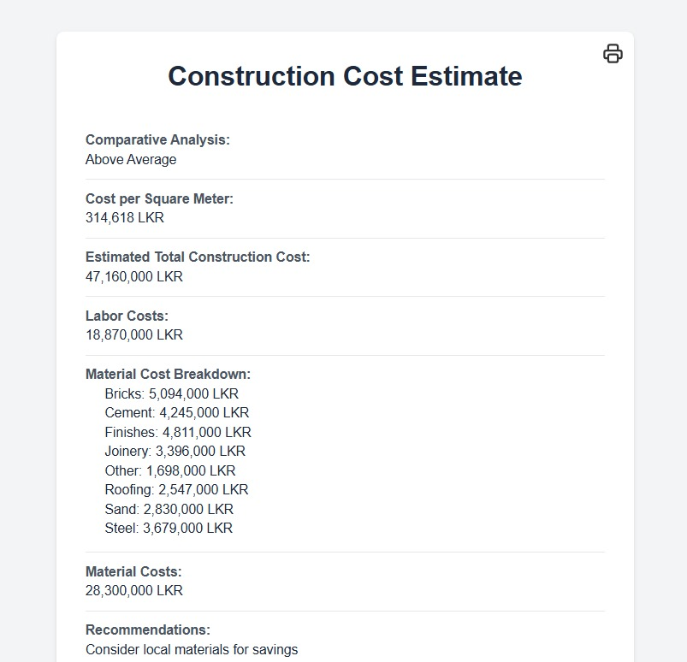
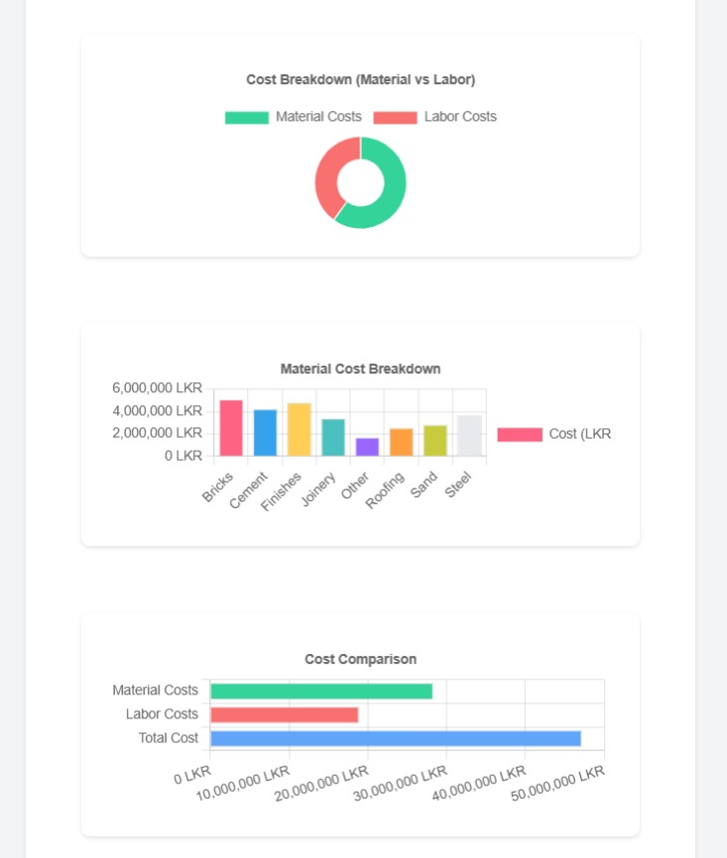
WORKING PRODUCT

Slide 40
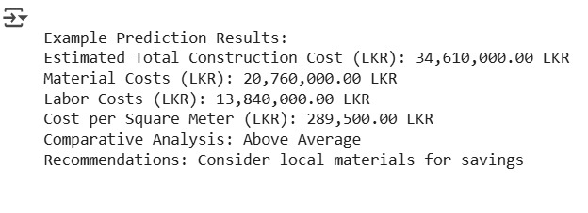
TESTING

Slide 41
REFERENCES
[1] Sphurti S. Arage and Nagaraj V. Dharwadkar, "Cost Estimation of Civil Construction Projects Using Machine Learning Paradigm," IEEE. Available: [https://ieeexplore.ieee.org/document/8058249](https://ieeexplore.ieee.org/document/8058249).
[2] Sanaz Tayefeh Hashemi, Omid Mahdi Ebadati, and Harleen Kaur, "Cost Estimation and Prediction in Construction Projects: A Systematic Review on Machine Learning Techniques," SN Applied Sciences, vol. 2, article 1703, September 2020. Available: [https://link.springer.com/article/10.1007/s42452-020-03497-1](https://link.springer.com/article/10.1007/s42452-020-03497-1).
[3] Salman Saeidlou and Nikdokht Ghadiminia, "A Construction Cost Estimation Framework Using DNN and Validation Unit," Available: [https://www.tandfonline.com/doi/full/10.1080/09613218.2023.2196388](https://www.tandfonline.com/doi/full/10.1080/09613218.2023.2196388).
[4] Suchitha, N. V., Adithya, S., Ashik, S., Dhanush, S., & Thrinsh Reddy S. G. (Year). Home construction cost estimation using ML. Sri Dharmasthala Manjunatheshwara Institute of Technology. Retrieved from https://www.irejournals.com/formatedpaper/1704488.pdf
IT21158018 | R A AHAMED | 24-25J-201

Slide 42

IT21301254 | Silva A.A.I
BSc (Hons) in Information Technology Specializing in IT
IT21301254 | Silva A.A.I | 24-25J-201

Slide 43
Introduction
Overview:
The Interior Design Collaboration Platform bridges communication gaps between clients and designers. By helping clients express their ideas more clearly, it reduces misunderstandings and inefficiencies, streamlining the design process.
Project Aim:
Develop an interactive design dashboard that integrates text and image inputs, enabling clear, real-time communication between clients and interior designers for better understanding and faster decision-making.
IT21301254 | Silva A.A.I | 24-25J-201

Slide 44
Research problem
Communication Gap- Clients have a clear vision but lack the technical language to communicate effectively with interior designers, leading to misunderstandings, design iterations, and delays.
Inefficiency and Rework- Clients' inability to clearly express design preferences leads to multiple revisions, inefficiencies, higher costs, and reduced productivity, affecting client satisfaction.
IT21301254 | Silva A.A.I | 24-25J-201

Slide 45
Objectives
Main Objective :
Specific Objectives
Utilize AI LLM-powered image generation to visualize client design ideas accurately.
Implement a reinforcement learning-based recommendation system that adapts to client preferences according to reward feedback.
Develop an AI-driven platform to enhance client-designer communication and improve design efficiency.
IT21301254 | Silva A.A.I | 24-25J-201

Slide 46

Research Gap
Existing platforms lack integration of text and image inputs for complete design communication.
Current tools do not use advanced AI LLM-driven image generation for accurate visualizations.
Traditional systems miss out on reinforcement learning algorithms like Q-learning for adapting recommendations.
Current platforms do not use policy-gradient methods for optimizing design suggestions in real-time.
Platforms lack adaptive learning to improve recommendation relevance based on client feedback.
IT21301254 | Silva A.A.I | 24-25J-201

Slide 47
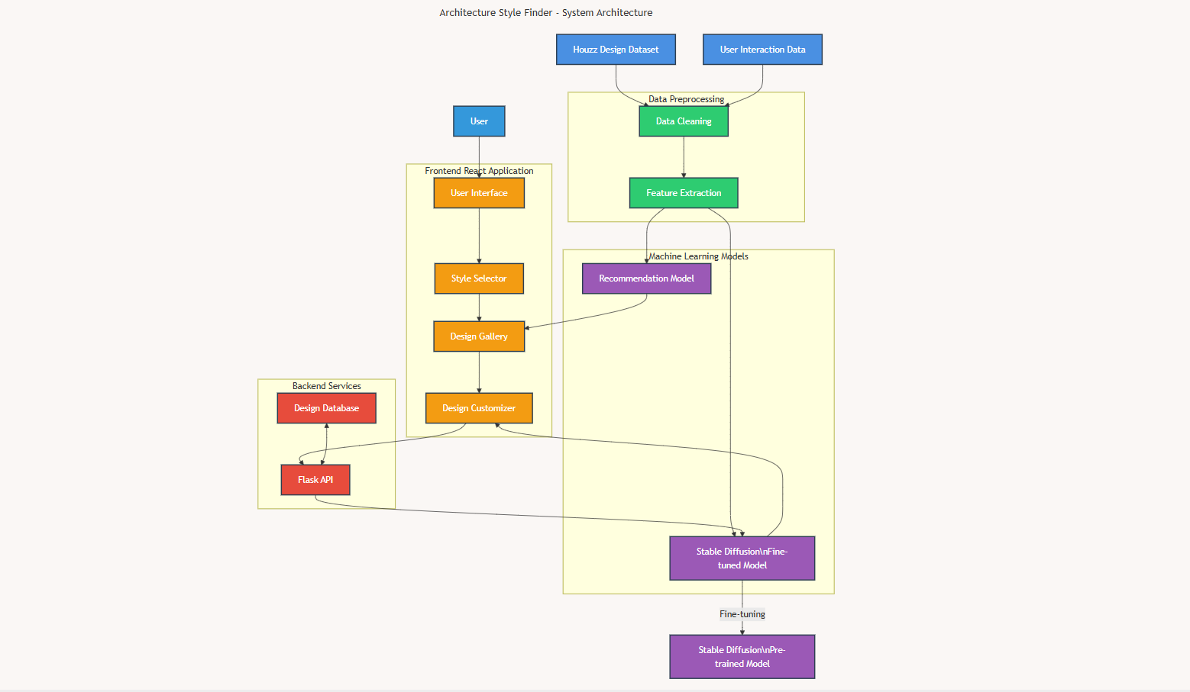
Component Diagram
IT21301254 | Silva A.A.I | 24-25J-201

Slide 48
Technologies Used
Backend: Python
Frontend: React (vite)
AI and Machine Learning: Tensor flow, Stable Diffusion, Hugging Face
Recommendation System:
API: Flask API
Model training: Google Colab
Technologies
and
Algorithms
IT21301254 | Silva A.A.I | 24-25J-201

Slide 49
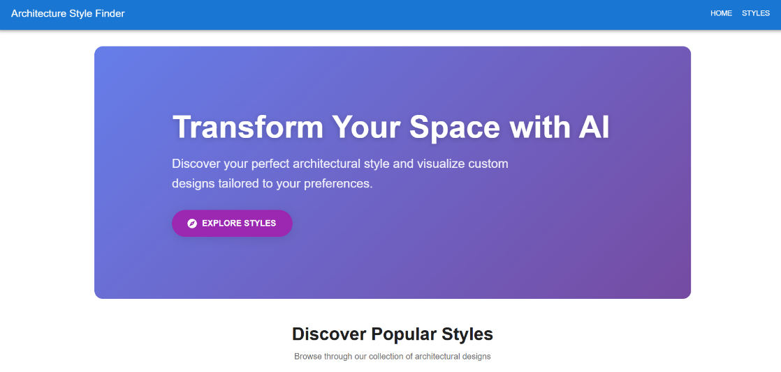
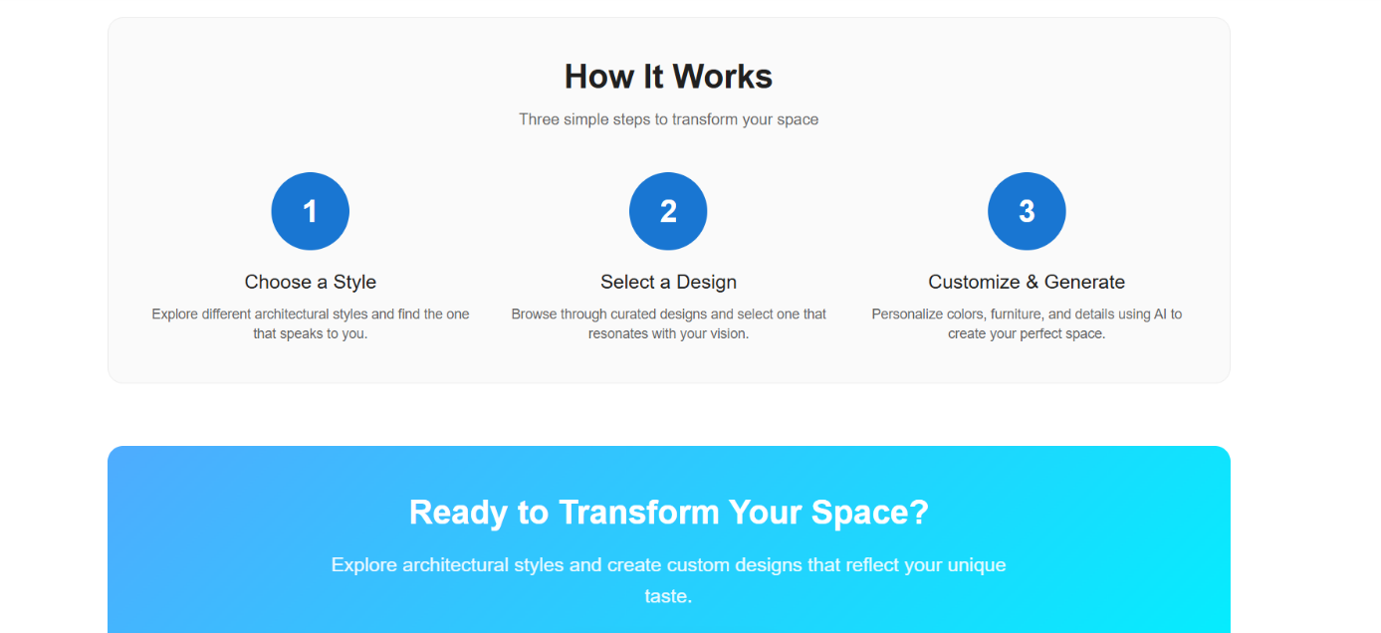
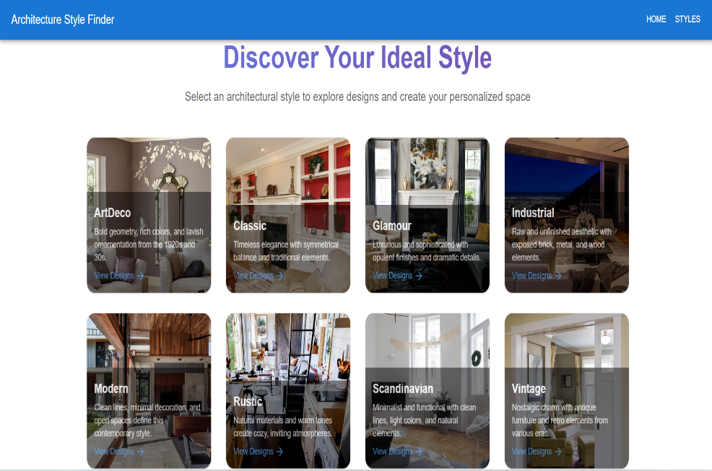
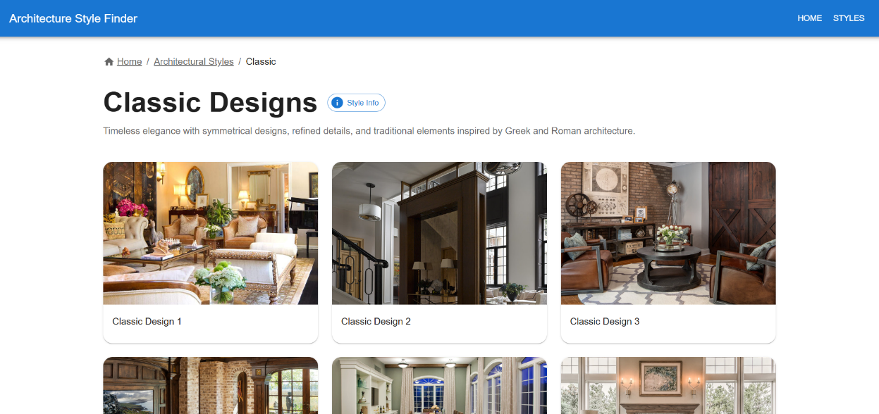
Project Evidences
Frontend Development

Slide 50
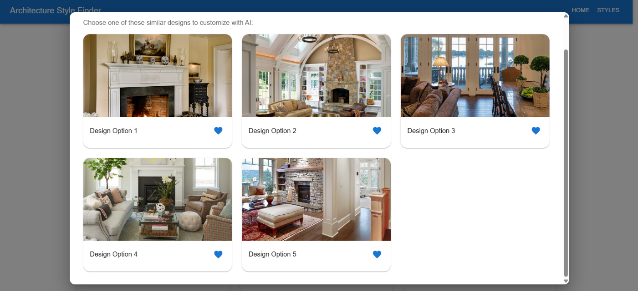
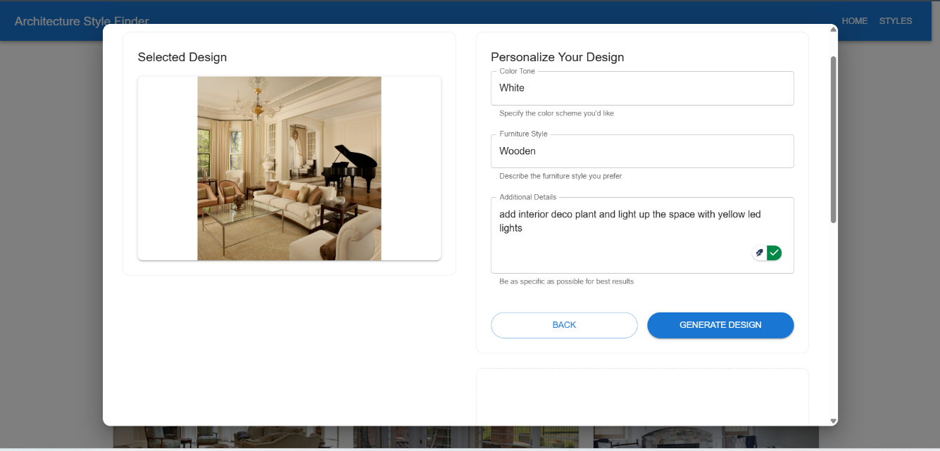
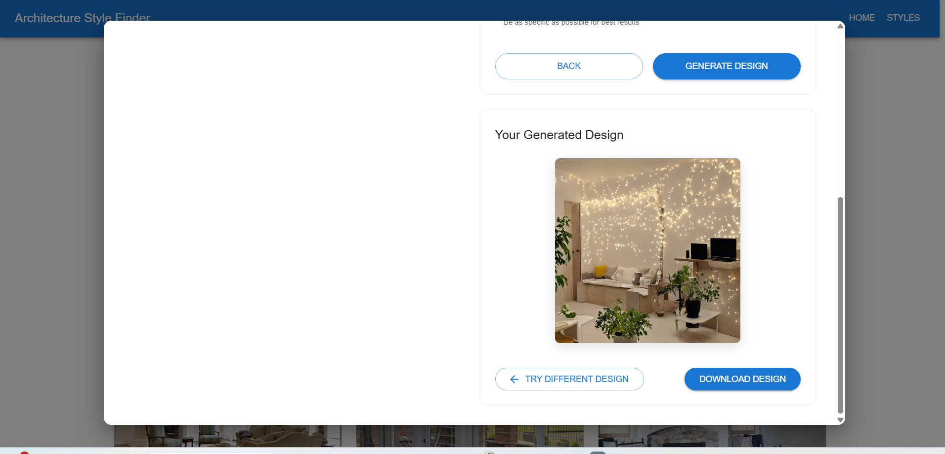

Slide 51
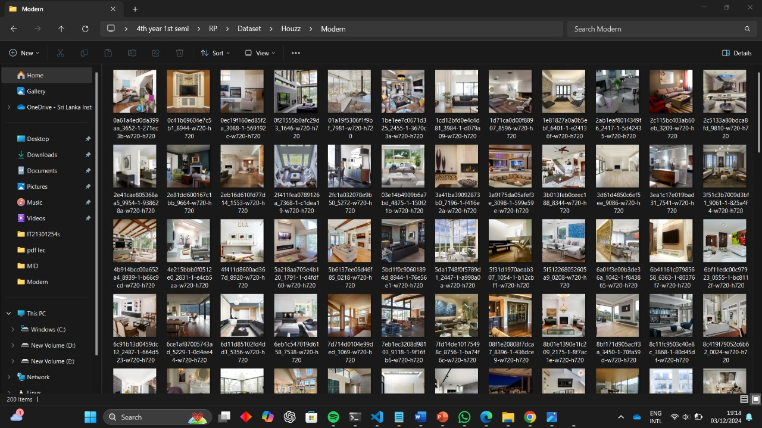
Data collection & Model Training
Houzz dataset

Slide 52
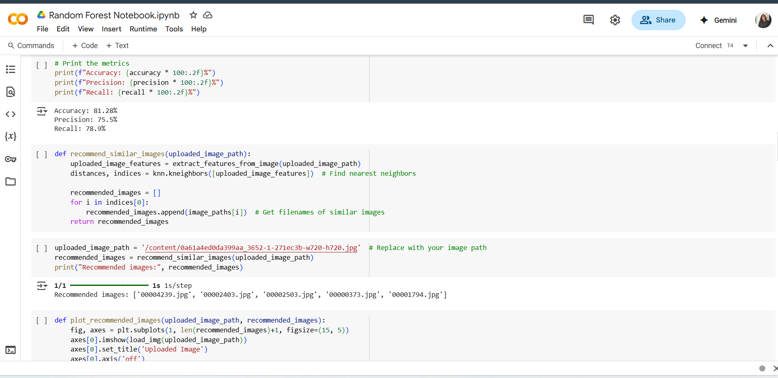
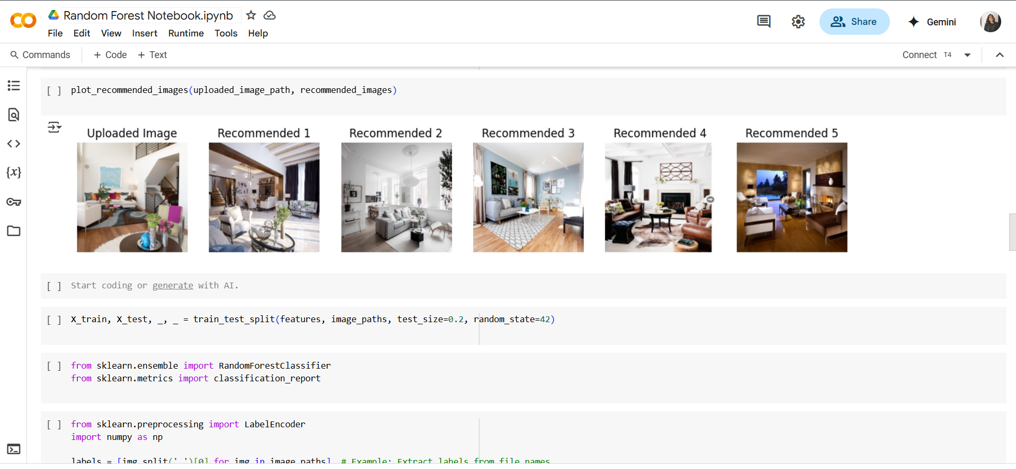
Model Performance

Slide 53
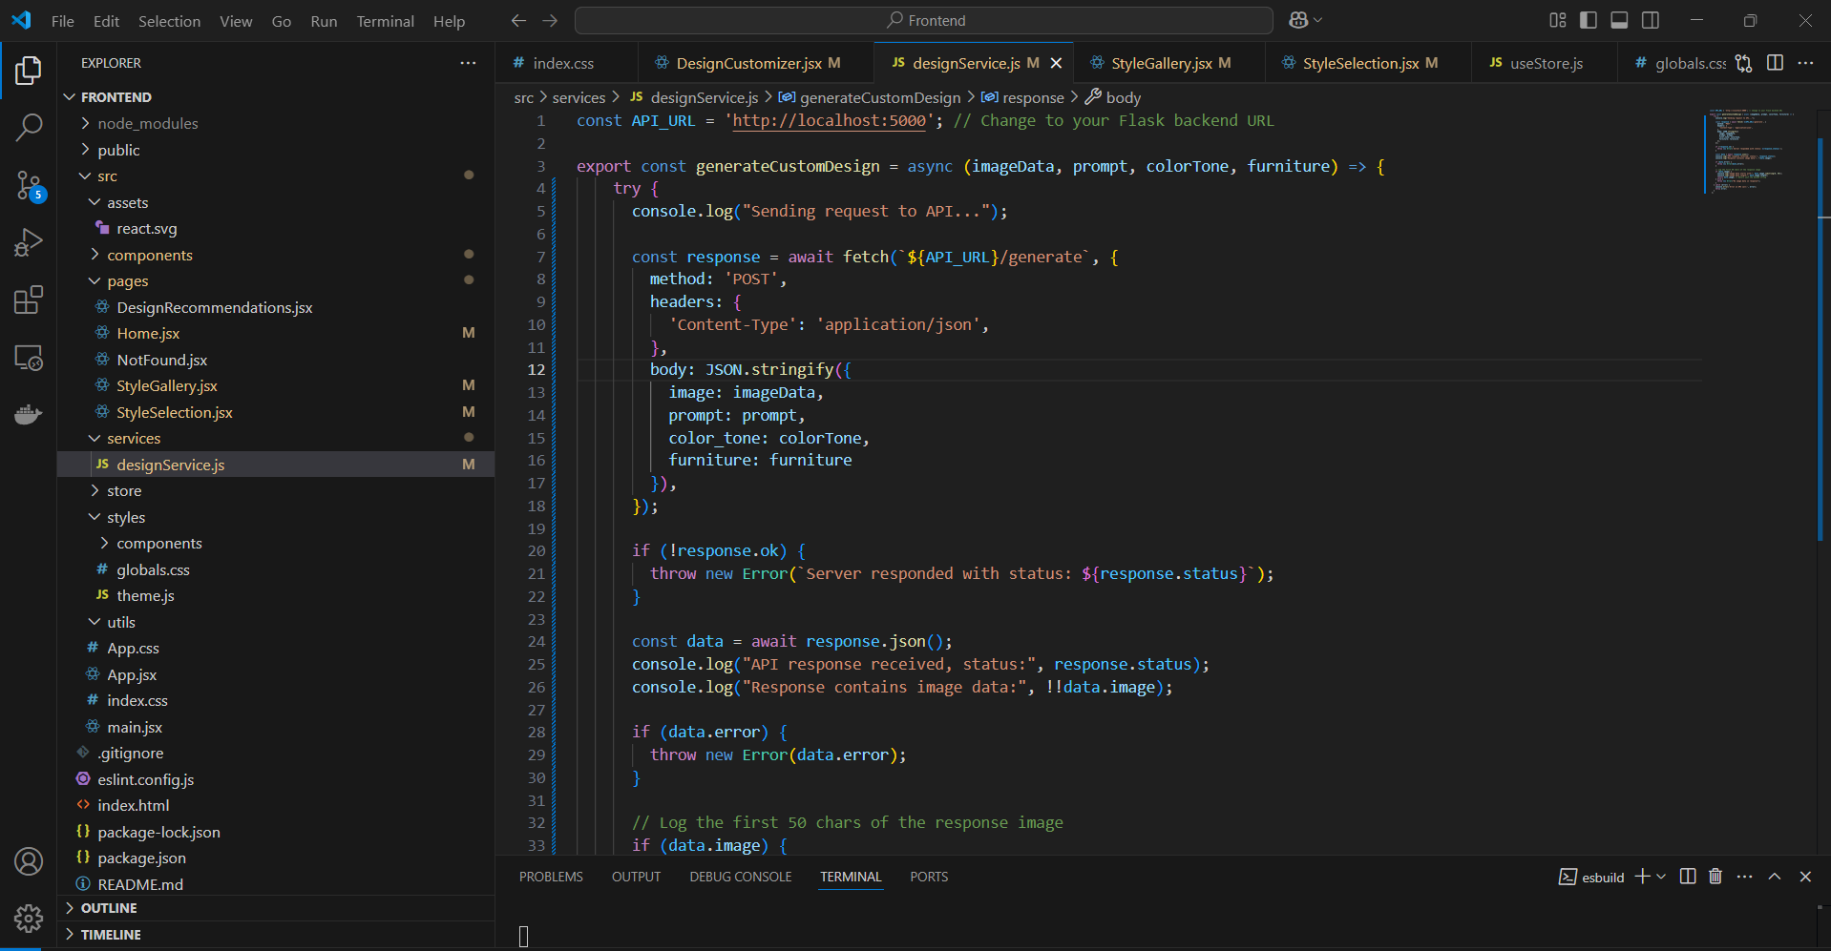
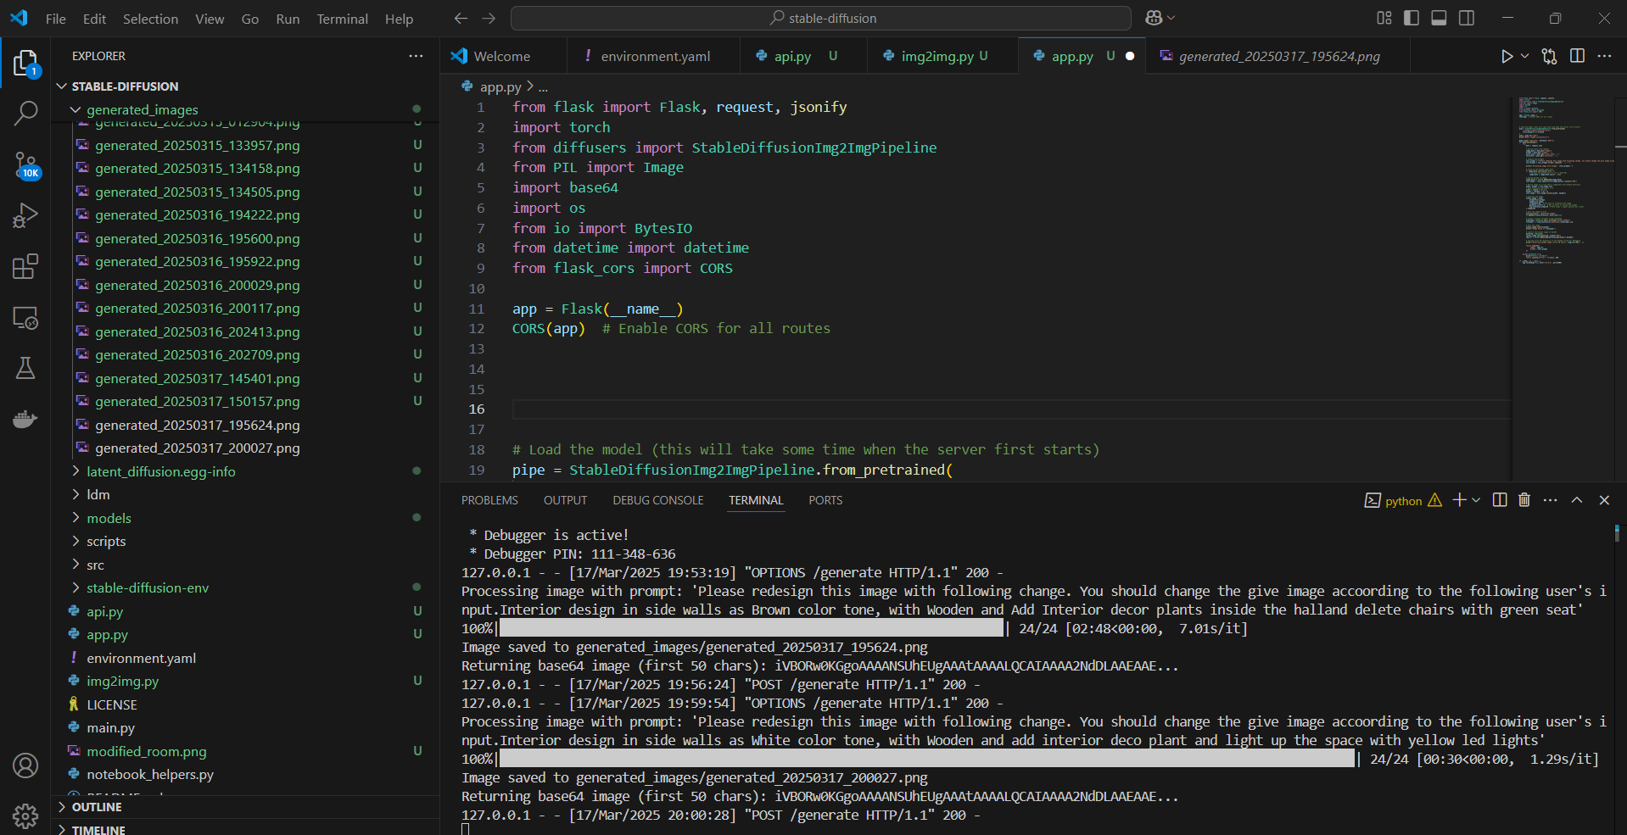
Integration

Slide 54
REFERENCES
[1] DUMITRUX, "Architectural Styles," Available: [https://www.kaggle.com/datasets/dumitrux/architectural-styles-dataset]
[2] Zhe Xu, Ya Zhang, Dacheng Tao, and Junjie Wu, "Architectural Style Classification Using Multinomial Latent Logistic Regression," Shanghai Jiao Tong University, Sun Yat-Sen University, 2014. Available: [https://www.researchgate.net/publication/275604099_Architectural_Style_Classification_Using_Multinomial_Latent_Logistic_Regression]
[3] Nima Norouzi, Maryam Shabak, Mohamed Rashid Embi, and Tareef Hayat Khan, "The Architect, the Client and Effective Communication in Architectural Design Practice," Universiti Teknologi Malaysia, Islamic Azad University, January 2015. Available: [https://www.researchgate.net/publication/273501174_The_Architect_the_Client_and_Effective_Communication_in_Architectural_Design_Practice]
[4] Feiyang Pan, Qingpeng Cai, Pingzhong Tang, Fuzhen Zhuang, and Qing He, "Policy Gradients for Contextual Recommendations." Available: [https://arxiv.org/abs/1802.04162](https://arxiv.org/abs/1802.04162).
IT21301254 | Silva A.A.I | 24-25J-201

